Slide 1
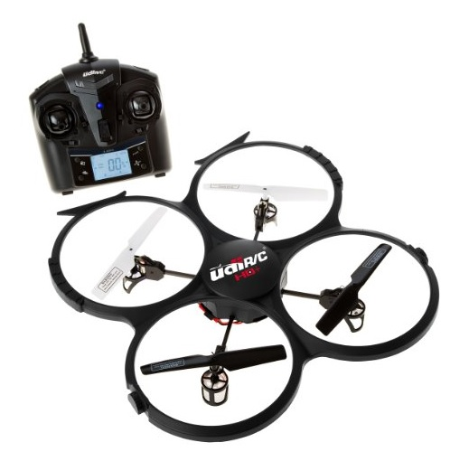
Position Control in Quadcopter Drones
Presented by:
Pragna Munagala
Bhargava Kalla

Slide 2
Contents
Introduction
Working
Flow Diagram
Challenges
Sensors
ESC and Flight Tracker
Communication
Stability Control
Research work
Applications
Limitations
References

Slide 3
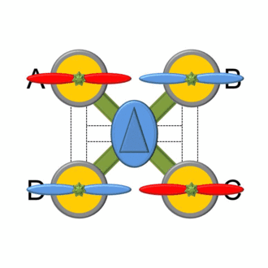
Introduction
Manually controlled mechatronic devices.
Equipped with gps, position control sensors in-order to maintain the flight.
Motors rotate in both clockwise and anticlockwise in order to maintain the pitch and altitude.

Slide 4
Working
Height is determined by the amount of power to all four motors.
Forward motion - driving the back props faster than the forward props.
Sideways motion - by running the left or right props faster.
Turning left or right - by slowing or speeding diagonal motors.
The control signals are passed from the transmitter using wireless technologies like wifi, bluetooth etc.
Based on these signals and additional data like air drift, gravitational force, the drone has to estimate the speed of rotors.
Data from sensors is collected and sent to the transmitter to get the current position and distance.

Slide 5
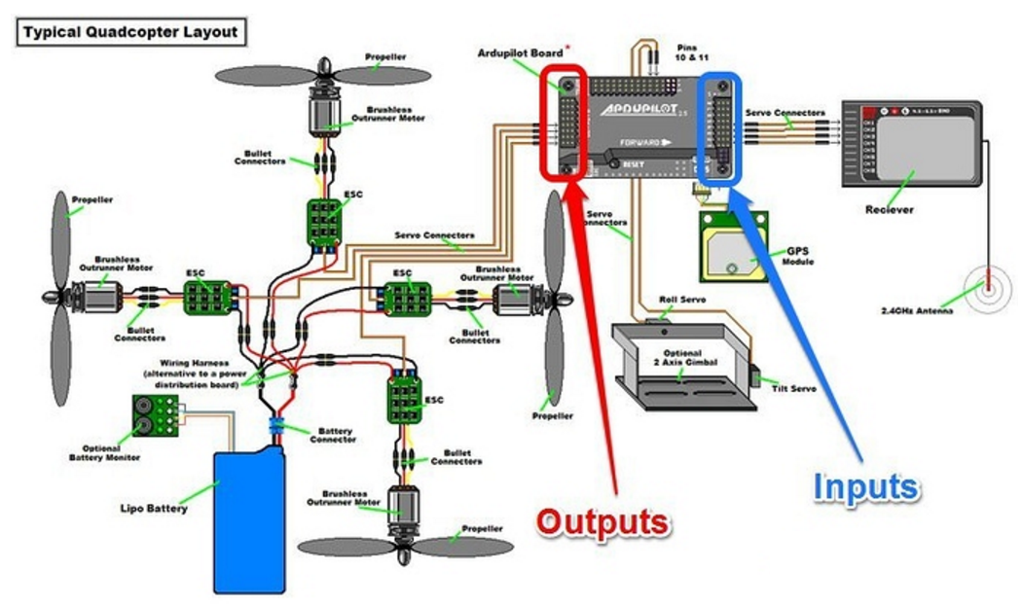
Work Flow diagram
Collection of data from sensors
Transmitter
Analyzing the input
Rotation of motors
Filtering
Stability control
Send the data back to transmitter

Slide 6
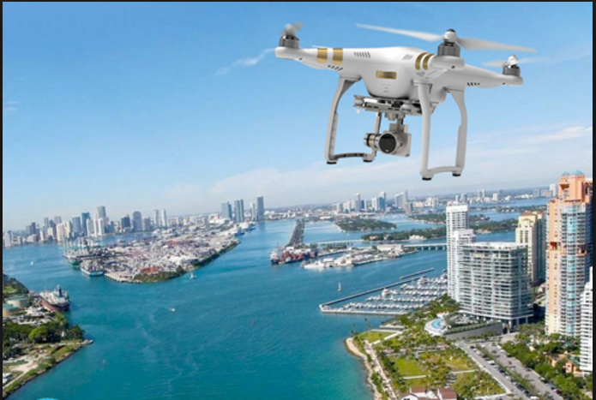
Challenges
Data must be sent at very low latencies in order to maintain a stable flight.
What happens when the connectivity is lost?
Speed of air is a drawback too. Isn’t it?
Interference with other signals.
Obstacles?
Where am I :(
??

Slide 7
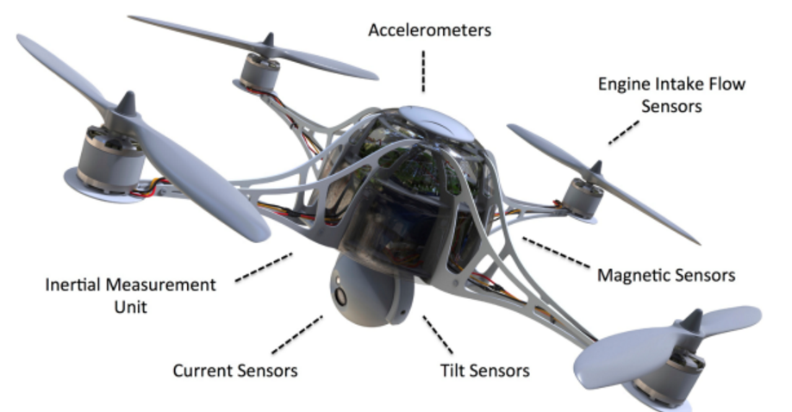
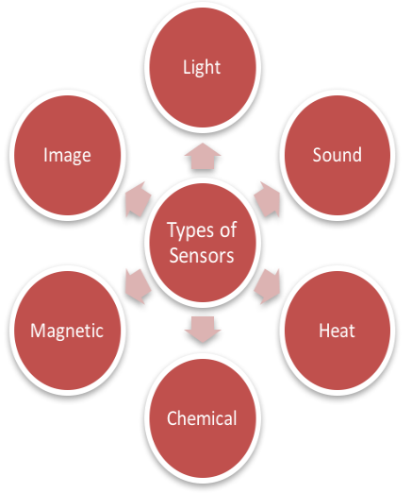
Sensors
Accelerometer
Gyroscope
Magnetometer
GPS
Camera
Infrared or ultrasonic

Slide 8
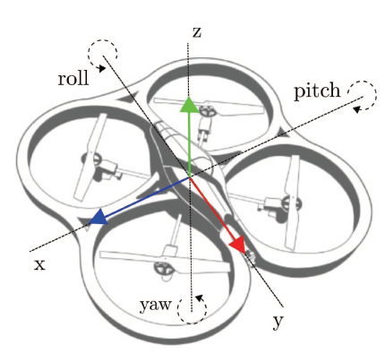
Position Control
Gyroscope
Feeds the controller with aircraft rotating information around its own axes - roll, pitch, yaw.
PID controller uses this information to stabilize the aircraft.
UAV shouldn’t rotate if no deflection from pilot. If rotates, gyro information is noted and counteraction is provided to prevent the unintended rotation.
Controller translates to desired rotation rate if pilot applies deflection.
Gyros are connected over I2C or SPI buses to provide data with frequency of 1kHz, 8kHZ.
Most popularly used - MPU6000 and MPU6050

Slide 9
Position Control (contd..)
Accelerometer
Provides information about acceleration forces in X, Y and Z axises.
Accelerometer data helps to determine up, down and current altitude.
Pilot's input are translated by the controller to desired inclination.
Cannot differentiate earth’s gravity and aircraft acceleration and are easily affected by vibrations.
Usually integrated with Gyroscopes as in MPU6000 and MPU6050.
Headless mode.
Barometer
Measures air pressure. As pressure drops with height can also used to measure the altitude.

Slide 10
Position Control (contd..)
Magnetometer
Present in drones with GPS.
Measures magnetic field of earth and is used to determine direction of compass in drone.
Distance Sensor
To sense the obstacles to avoid collisions.
Based on ultrasonic, infrared and laser.

Slide 11
Position Control (contd..)
GPS Sensor
Determines the geographical position of drone.
Controller compares desired position with current position and determines the direction in which drone has to move.
Auto return Home feature:
Without GPS:
Just flyback in the opposite direction in case of low power or loss of connectivity.
With GPS:
Remember the starting position (latitude and longitude) of the drone.
In case of lost signal or low battery, use GPS sensor to return to the saved location.

Slide 12
Electronic Speed Control (ESC)
Electronic circuit to vary electric motor’s speed, direction.
Act as dynamic brake.
UAV includes one ESC for each electric motor.
Offers high power, high frequency to motors in an extremely compact package.
ESC is critical for reporting each motor’s RPM to the flight controller, allowing it to take corrective action if needed.
Includes features
provides high-current, direct current electric power to electric motors
Maximum power output for all UAV electric motors is limited
Computer Programmable

Slide 13
UAV Flight Tracker
Detects and prevents potential collisions by automatically adjusting UAV flight paths and then alerting users to the change.
Cloud based control and management system.
Client and server model.
Consists of three entities - client, server and UAV.
Client - control added UAVs, receive real time sensor updates and priority alerts.
Server - provides sensor and collision information to client, collision detection algorithms, manages user profiles and updates UAV control information.
UAV management module - UAV Management
- UAV control
- collision management

Slide 14
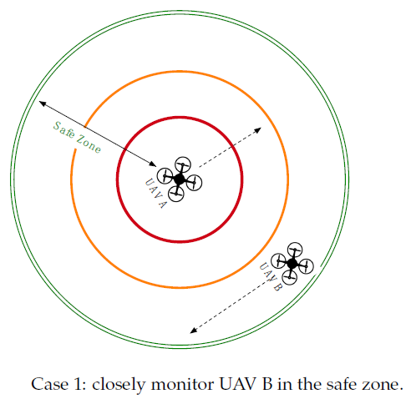
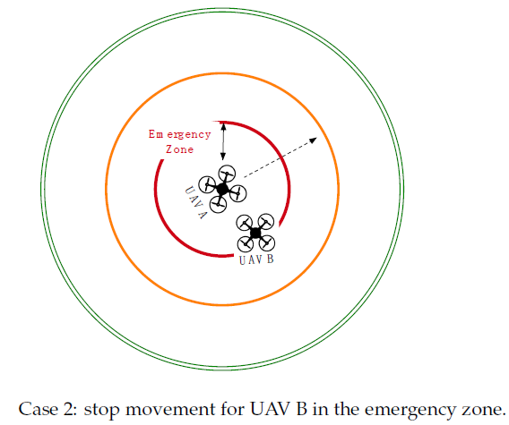
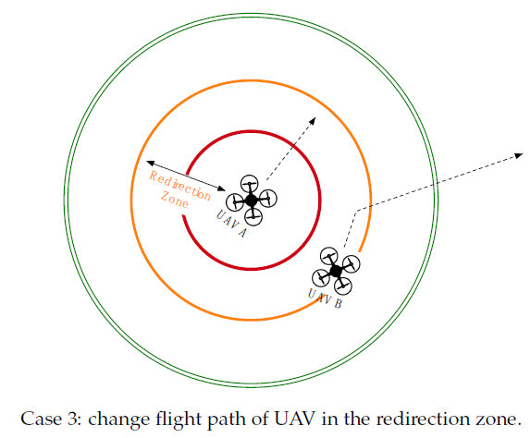
Collision avoidance

Slide 15
Communication
Bluetooth
Wifi
Higher frequencies in 2.4 GHz range.
Works on an ultra-high radio frequency so range is limited to about 600 meters.
Able to handle both data and image transmission.
Radio Frequency
Transmitter and Receiver tuned to same frequency.
Transmitter and receivers paired using RFID.
Most remote control drones use 900 MHz for transmission.

Slide 16
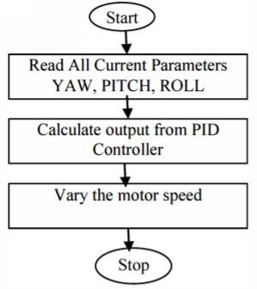
Stability Control
Use of filters
PID controller
Feedback mechanism
Flow Chart for PID

Slide 17
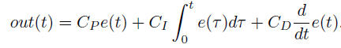
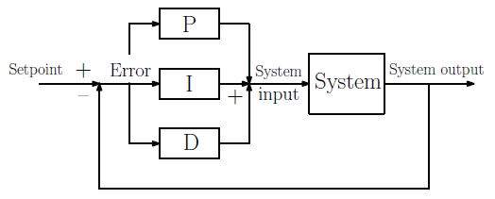
PID Controller
Constant corrections are needed for multicopter to be stable in air.
Stability is maintained using PID control loop.
Separate controller for each of roll, pitch and yaw axis. Works based on rotation speed provided by gyros.
Weighted sum of these terms is used to adjust the system parameters to predict the correct output out at any time t.
Notes:
P works on current error ‘e(t)’. I works on past error ‘∫e(T)dT’. D works on future error ‘d/dt(e(t))’.

Slide 18
Academic Research
1. Auto charging platform and flight algorithms including auto landing.
2. Object detection and Tracking
Critical part of target tracking - detection of target from video stream captured by drone’s front camera.
Two approaches to follow the target
Using known location of target, the motion between successive frames is estimated and target’s next location is determined.
Using template matching, feature detection and matching, the target in static picture is detected.

Slide 19
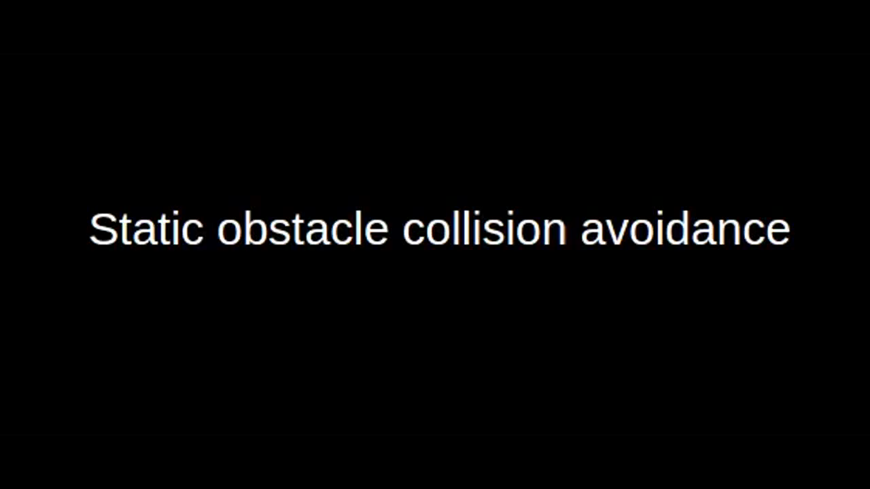
Demo on few Drone modes:

Slide 20
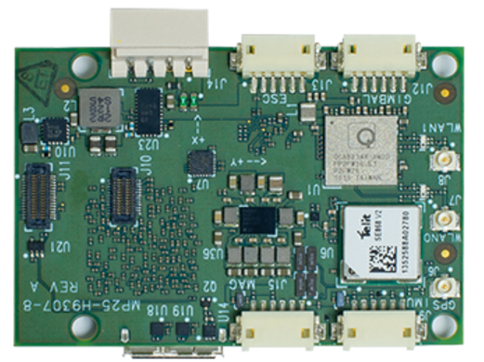
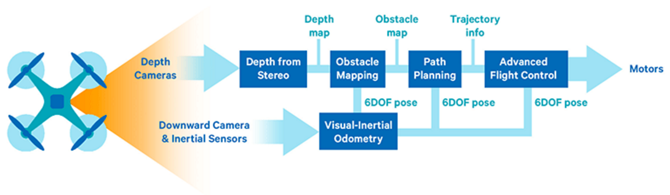

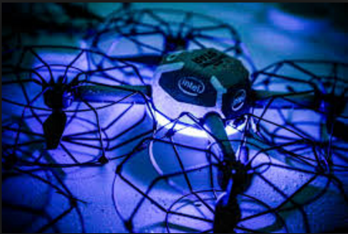
Industrial Research
Snapdragon Flight - Qualcomm
Intel setup a Guinness world record with 500 Intel shooting star drones flying simultaneously.
Motors spinning updation in Snapdragon Flight
Snapdragon soc

Slide 21
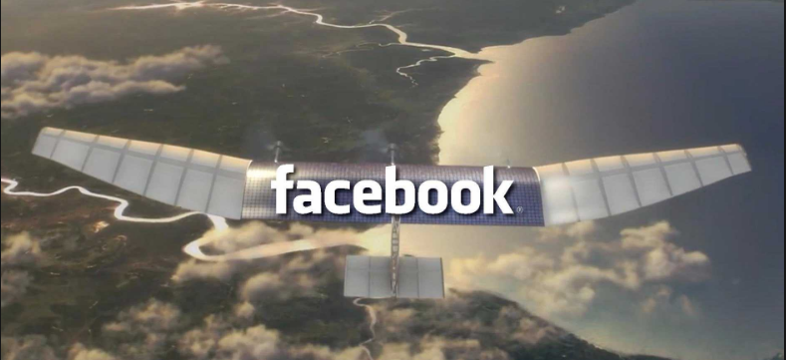
Industrial Research (contd..)
Aquila - Facebook’s internet beaming drone. Using millimeter-wave radio technology to transmit data to the drone.
"Our goal is simple: We want to connect the 4.1 billion people who aren't already connected to the internet," Facebook CTO Mike Schroepfer said during a speech on stage.

Slide 22
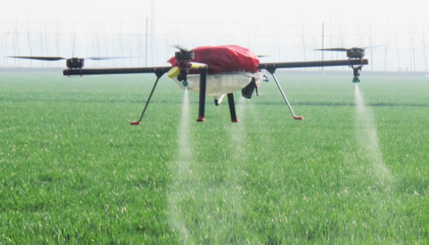
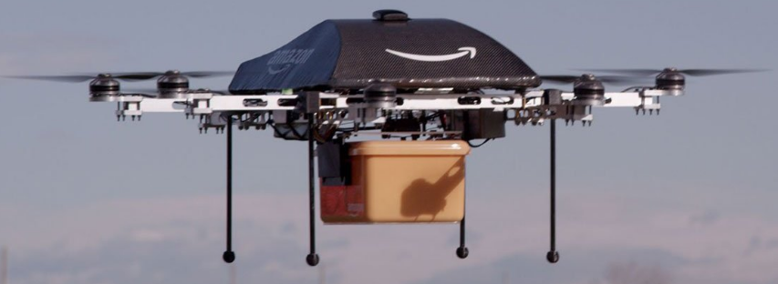
Applications
Security
Inspection
Science & Research
Defense
Agriculture
Photography
Movie making
Search and Rescue

Slide 23
Limitations
Range
Battery Life
Weight
Individual Privacy
Drone collisions
Property damage

Slide 24
References
[1] Orozco, Luis, et al. "Design and implementation of a control of position system for the quadricopter AR. Drone 2.0 by Parrot." Automatica (ICA-ACCA), IEEE International Conference on. IEEE, 2016.
[2] Itkin, Mason, Mihui Kim, and Younghee Park. "Development of Cloud-Based UAV Monitoring and Management System." Sensors 16.11 (2016): 1913.
[3] Barták, Roman, and Adam Vykovský. "Any Object Tracking and Following by a Flying Drone." Artificial Intelligence (MICAI), 2015 Fourteenth Mexican International Conference on. IEEE, 2015.
[4] Woo, Chungki, et al. "Auto charging platform and algorithms for long-distance flight of drones." Consumer Electronics (ICCE), 2017 IEEE International Conference on. IEEE, 2017.
[5] Murrieta-Rico, Fabian N., et al. "Resolution improvement of accelerometers measurement for drones in
agricultural applications." Industrial Electronics Society, IECON 2016-42nd Annual Conference of the IEEE .
IEEE, 2016.

Slide 25
QUERIES ???

